Slide 1
UMD DATA605 - Big Data Systems DevOps with Docker

Slide 2
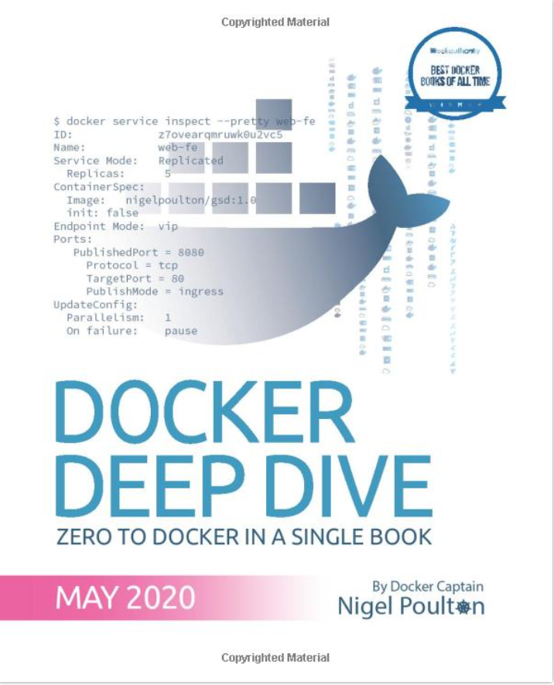
Docker - Resources
Mastery:
Poulton, Docker Deep Dive: Zero to Docker in a single book, 2020
Google SRE book TODO
Web resources
A Beginner-Friendly Introduction to Containers, VMs and Docker
Official Docker Getting Started Tutorial
In this course, we will use Docker containers in order to easily set-up the environments to work with big data systems

Slide 3
DevOps
DevOps = practices that combines software development (devs) and IT operations (ops)
Problem: for many Internet companies, the application is the business
E.g., Amazon, Expedia, Google, Facebook
If the application breaks, the business stops working
Solutions:
Before virtualization (before 2000s)
Virtual machine era (2000s-2010s)
Container era (> ~2013)
Container technology revolutionized DevOps
Enable true independence between applications and IT ops
Create a model for better collaboration (fewer conflicts) and innovation
“It doesn’t work!”
“What? It works for me”

Slide 4
Before Virtualization
< 2000s
“Run on the metal”
Running multiple applications on the same server was not safe and secure
IT would buy a new server for each application
Difficult to spec the machine
Buy “big and fast servers”
Overpowered servers operating at 5-10% of capacity
Tons of money in the DotCom boom was spent on machines and networks

Slide 5
Virtual Machine Era
Circa 2000
Pros
VM ran safely and securely multiple applications on a single server
IT could run apps on existing servers with spare capacity
Cons
Every VM requires an OS (waste of CPU, RAM, and disk)
Monitor and patch each OS
Buy an OS license
VMs are slow to boot

Slide 6
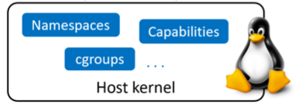
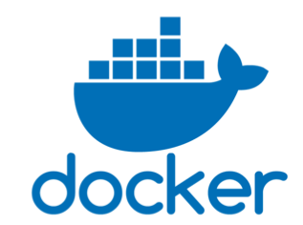
Containers Era
Circa 2013
Pros
Containers don’t require full-blown OS
All containers run on a single host
Reduce OS licencing cost
Reduce overhead of OS patching and maintenance
Containers are fast and portable
Linux supported containers for some time
Kernel namespaces
Control groups
Union filesystems
Docker
Didn’t invent containers
Made containers simple and mainstream

Slide 7
Serverless Computing
Containers run in a Virtual Machine which runs on a host, e.g.,
Your laptop
On premise
Cloud instance (e.g., EC2)
On a virtual machine
On a virtual machine running a virtual machine
Bare-metal server
As long your code runs somewhere, you don’t care “how” or “where” (serverless)

Slide 8
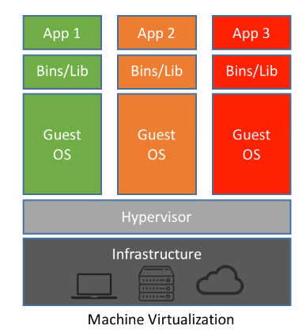
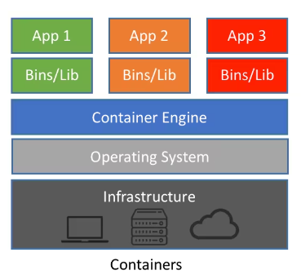
OS vs Container Virtualization
VMs
Hypervisor boots
Hypervisor performs HW virtualization
Carves out physical hardware resources into VMs
Resources (CPU, RAM, storage) are allocated to a VM
“VM tax”: to run 4 apps, need 4 VMs and 4 OSes
Each VM requires time to start
Consume CPU, RAM, storage
Need a license
Need admins
Containers
Docker performs OS virtualization

Slide 9
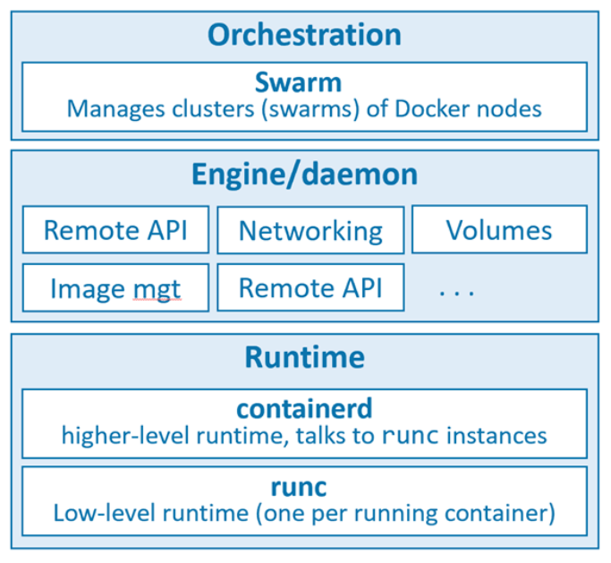
Docker Architecture
Docker run-time
runc: start and stop containers
containerd:
Pull images
Create volumes, network interfaces
Docker engine
dockerd:
Expose remote API
Manage images, volumes, networks
Docker swarm
Manage clusters of node
Replaced by Kubernetes
Open Container Initiative (OCI)
Standardize low-level components of container infrastructure
E.g., image format, run-time API
“Death” of Docker

Slide 10
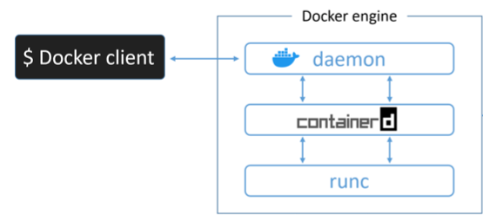
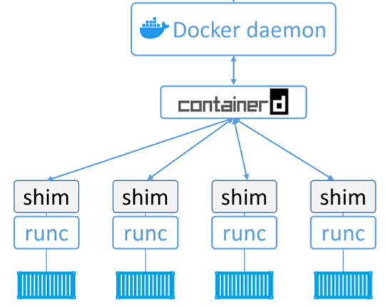
Docker: Server-Client
Server-client architecture
Docker client
Command line interface
Communicate through IPC socket /var/run/docker.sock or IP ports
Docker engine
Run and manage containers
Modular and built from several OCI-compliant sub-systems
E.g., Docker daemon, containerd, runc, plug-ins for networking and storage

Slide 11
Ops vs Devs
Devs
Implement the app (e.g., Python, virtual env)
Containerize the app
Create Dockerfile
Contain the instruction on how to build an image
Build image
Run app as a container
Test locally
Ops
Download image
Contain filesystem, application, app dependencies
It’s like a “class” in Python (or a stopped VM)
Start container
It’s like an object = instance of an object
Run command
Destroy container
In case of issues, it’s easy to repro the problem
Here is the log
Run this command line
Deploy on a test system and debug

Slide 12
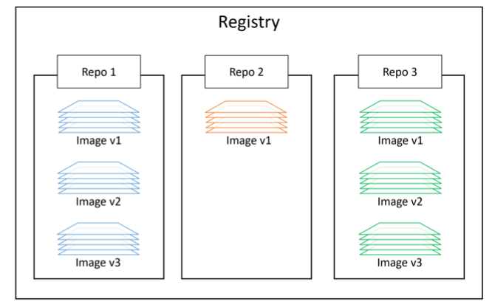
Docker Containers
Docker Containers
Lightweight, stand-alone, executable software package
Includes everything needed to run
E.g., code, runtime, system tools, system libraries, settings
Run-time objects
vs Docker images are built-time objects
Docker repos
Store Docker images
<registry>/<repo>:<tag> alpine:latest
E.g., DockerHub, AWS ECS
Some repos are vetted by Docker
Unofficial repos shouldn’t be trusted

Slide 13
Docker Image
Docker images
Unit of deployment
Contain everything needed by an application to run
Application code
Application dependencies
Minimal OS support
Can build images from Dockerfiles
Can pull pre-built from image registry
Multiple layers stacked on top of each other
Typically few 100s MBs

Slide 14
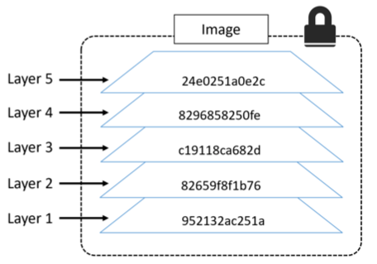
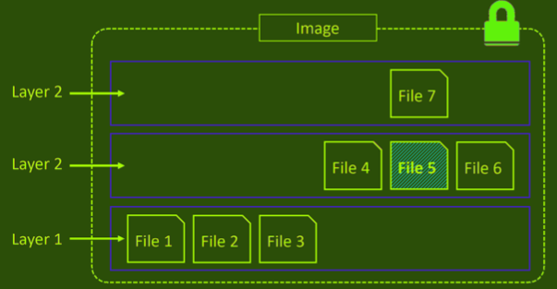
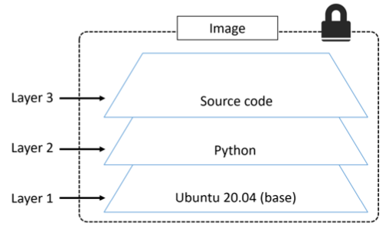
Docker Image Layers
A docker image is a configuration file that lists the layers and some metadata
It is composed of read-only layers
Each layer comprising one or more files
Each layer is independent from each other
Docker driver:
Stacks these layers representing them as a unified filesystem
Files from the top layers can obscure the files from the bottom layer
Implements a copy-on-write behavior
Each layer has hash
Hash is based on their content
Images are pulled and pushed compressed the hash of a compressed layer is different
A "distribution hash" is used
Each image has a hash:
The hash is function of the config file and of the layers
When an image changes, a new hash is generated

Slide 15
Docker: Container Data
Data inside of containers is persisted as long as the container is not killed
If you stop or pause a container data is not lost
Containers are designed to be immutable
It's not good practice to write “persistent” data into containers
Bind-mounting a local dir
A local dir is mounted to a dir inside a container
Docker provides volumes that exist separately from the container
E.g., to store the content of a Postgres DB

Slide 16
Containerizing an app
Develop your application code using the needed dependencies
Directly inside a container
Inside a virtual env
Create a Dockerfile describing
your app
its dependencies
how to run it
Build image with `docker image build`
(Optional) Push image to a registry
Run container from image

Slide 17
Building a container
Dockerfile
Describe how to create a container
Build context
> docker build -t web:latest .
Directory containing the application and its dependencies
Typically the Dockerfile is in the root directory of the build context

Slide 18
Docker Volumes

Slide 19
Docker Networks

Slide 20
Docker commands
Usage: docker [OPTIONS] COMMAND
A self-sufficient runtime for containers
Options:
--config string Location of client config files (default "/Users/saggese/.docker")
-c, --context string Name of the context to use to connect to the daemon (overrides DOCKER_HOST env var and default context set
with "docker context use")
-D, --debug Enable debug mode
-H, --host list Daemon socket(s) to connect to
-l, --log-level string Set the logging level ("debug"|"info"|"warn"|"error"|"fatal") (default "info")
--tls Use TLS; implied by --tlsverify
--tlscacert string Trust certs signed only by this CA (default "/Users/saggese/.docker/ca.pem")
--tlscert string Path to TLS certificate file (default "/Users/saggese/.docker/cert.pem")
--tlskey string Path to TLS key file (default "/Users/saggese/.docker/key.pem")
--tlsverify Use TLS and verify the remote
-v, --version Print version information and quit
Management Commands:
builder Manage builds
buildx* Docker Buildx (Docker Inc., v0.8.2)
compose* Docker Compose (Docker Inc., v2.6.1)
config Manage Docker configs
container Manage containers
context Manage contexts
extension* Manages Docker extensions (Docker Inc., v0.2.7)
image Manage images
manifest Manage Docker image manifests and manifest lists
network Manage networks
node Manage Swarm nodes
plugin Manage plugins
sbom* View the packaged-based Software Bill Of Materials (SBOM) for an image (Anchore Inc., 0.6.0)
scan* Docker Scan (Docker Inc., v0.17.0)
secret Manage Docker secrets
service Manage services
stack Manage Docker stacks
swarm Manage Swarm
system Manage Docker
trust Manage trust on Docker images
volume Manage volumes
Commands:
attach Attach local standard input, output, and error streams to a running container
build Build an image from a Dockerfile
commit Create a new image from a container's changes
cp Copy files/folders between a container and the local filesystem
create Create a new container
diff Inspect changes to files or directories on a container's filesystem
events Get real time events from the server
exec Run a command in a running container
export Export a container's filesystem as a tar archive
history Show the history of an image
images List images
import Import the contents from a tarball to create a filesystem image
info Display system-wide information
inspect Return low-level information on Docker objects
kill Kill one or more running containers
load Load an image from a tar archive or STDIN
login Log in to a Docker registry
logout Log out from a Docker registry
logs Fetch the logs of a container
pause Pause all processes within one or more containers
port List port mappings or a specific mapping for the container
ps List containers
pull Pull an image or a repository from a registry
push Push an image or a repository to a registry
rename Rename a container
restart Restart one or more containers
rm Remove one or more containers
rmi Remove one or more images
run Run a command in a new container
save Save one or more images to a tar archive (streamed to STDOUT by default)
search Search the Docker Hub for images
start Start one or more stopped containers
stats Display a live stream of container(s) resource usage statistics
stop Stop one or more running containers
tag Create a tag TARGET_IMAGE that refers to SOURCE_IMAGE
top Display the running processes of a container
unpause Unpause all processes within one or more containers
update Update configuration of one or more containers
version Show the Docker version information
wait Block until one or more containers stop, then print their exit codes
Run 'docker COMMAND --help' for more information on a command.
[1mTo get more help with docker, check out our guides at https://docs.docker.com/go/guides/[0m
version: "3.8"
services:
web-fe:
build: .
command: python app.py
ports:
- target: 5000
published: 5000
networks:
- counter-net
volumes:
- type: volume
source: counter-vol
target: /code
redis:
image: "redis:alpine"
networks:
counter-net:
networks:
counter-net:
volumes:
counter-vol:

Slide 21
Docker Tutorial
cd projects
vi tutorial_docker.md

Slide 22
Docker Compose
Docker Compose deploys and manages multi-container applications running on a single node
Describe the app in a single declarative configuration file
Instead of scripts with long Docker commands
Compose talks to Docker API to achieve what you requested
E.g., you need a client app and Postgres DB
E.g., microservices
Web front-end
Ordering
Back-end DB
In 2020 Docker Compose has become an open standard for “code-to-cloud” process
To run on multiple hosts
Docker Stacks / Swarm
Kubernetes

Slide 23
Docker Compose File
The default name for a Compose file is `docker-compose.yml`
You can specify `-f` for custom filenames
YAML file
Top-level keys are:
`version`:
Mandatory first line to specify API version
Ideally always use the latest version
Typically 3 or higher
`services`:
Define the different microservices
`networks`:
Creates new networks
By default it creates a `bridge` network to connect multiple containers on the same Docker host
`volumes`:
Creates new volumes
Key in services describe a different “service” in terms of container
Inner keys specify the params of Docker run command
version: "3.8"
services:
web-fe:
build: .
command: python app.py
ports:
- target: 5000
published: 5000
networks:
- counter-net
volumes:
- type: volume
source: counter-vol
target: /code
redis:
image: "redis:alpine"
networks:
counter-net:
networks:
counter-net:
volumes:
counter-vol:

Slide 24
Docker Compose: Commands
> docker compose --help
Usage: docker compose [OPTIONS] COMMAND
Docker Compose
Options:
--env-file string Specify an alternate environment file.
-f, --file stringArray Compose configuration files
-p, --project-name string Project name
Commands:
build Build or rebuild services
convert Converts the compose file to platform's canonical format
cp Copy files/folders between a service container and the local filesystem
create Creates containers for a service.
down Stop and remove containers, networks
events Receive real time events from containers.
exec Execute a command in a running container.
images List images used by the created containers
kill Force stop service containers.
logs View output from containers
ls List running compose projects
pause Pause services
port Print the public port for a port binding.
ps List containers
pull Pull service images
push Push service images
restart Restart containers
rm Removes stopped service containers
run Run a one-off command on a service.
start Start services
stop Stop services
top Display the running processes
unpause Unpause services
up Create and start containers
version Show the Docker Compose version information

Slide 25
Docker Compose: Tutorial
From https://github.com/nigelpoulton/counter-app
cd projects/tutorial_docker_compose/
vi tutorial_docker_compose.md

